Slide 1
Software UI Issues
Examples

Slide 2
Netflix Experience
Netflix claimed to have received back a video we never got.
Most likely due to a postal problem (torn envelope)

Slide 3
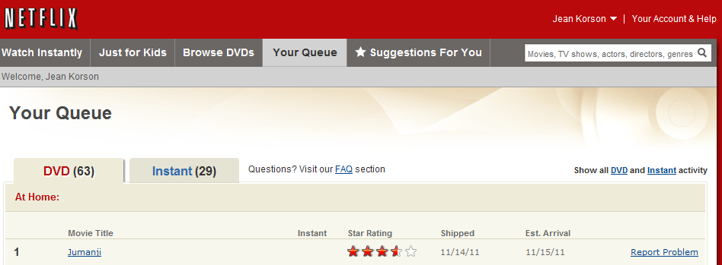
Reporting a Problem

Slide 4
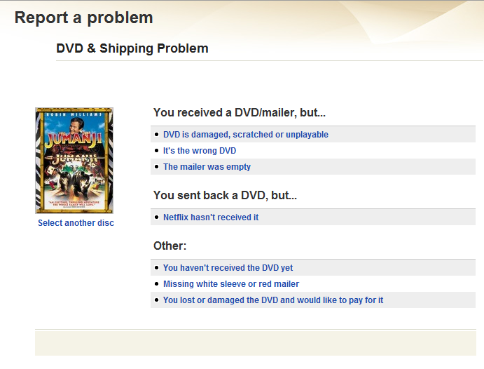
UI designer Missed an Option

Slide 5
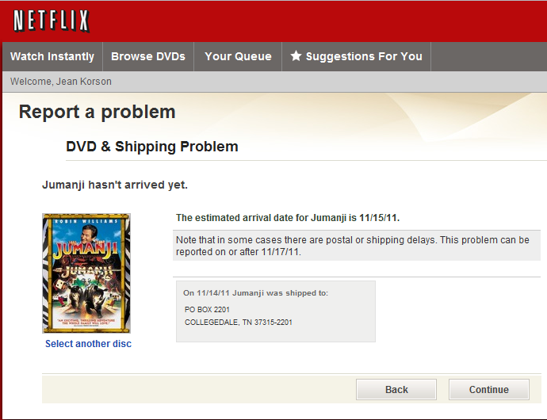
Still No Correct Option

Slide 6
UI Principle
Never assume you, as the UI designer, know all the options.
Do extensive usability testing and brainstorming to get as many options as possible
Include an “other” option in the UI

Slide 7
Exercise
Think of a software interface issue that frustrates you
Find a specific example that illustrates this issue – take a screen snapshot
Explain the problem and state the design principle that would solve the issue

